Slide 1
Love In A Time of Cholera (collisions in a time of covid)
BNL Collider accelerator response to covid-19

Slide 2
Timeline format for this talk
This color is for BNL/Operations/Main Control Room items
This color is personal as a member of Operations/human in a pandemic

Slide 3
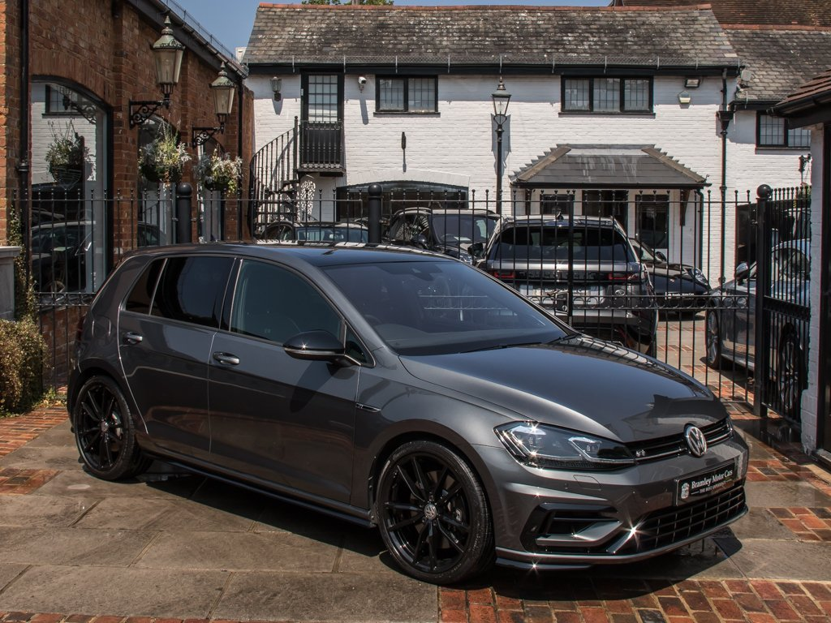
3/19/20 Thursday
Mask wearing was just starting to be a thing in NY, not mandatory
Most people were just hoping this wasn’t going to affect the US at this point
Economic concerns were emerging, especially among car dealers
I snagged a new VW Golf R for $7k below list. Only high point for the next several months

Slide 4
3/23/20 Monday
Positive cases in NY are up an order of magnitude in a week, it is clear “one day, it’s like a miracle, it will disappear” is not realistic
Brookhaven site closes at 1300 to all non-essential personnel
MCR shuts down the accelerator complex and a cryogenic warm-up begins for RHIC
NY state issues a statewide shutdown. Only essential businesses stay open
People are saying it will be at least a month before this blows over. I’m operating under the idea it will be at least a year. I transfer all my files on my work PC to OneDrive to allow remote access, grab my work laptop and my 43” desktop monitor and head home at 1300.

Slide 5
Next 3 weeks
BNL fully invests in the Microsoft suite for everything except meetings
MS Teams allows group chats and on demand video calls, that greatly helps with communication.
We stay with BlueJeans for meetings. It is awful. It turns on your camera and mic by default which sets up weeks of hilarity/embarrassment.
People settle into working from home. Lab issues telework agreement and remote meeting protocols.
Most people I know at this point are losing/have lost their job. BNL keeps everyone on and transitions to a new way of doing business.
With the break in Operations everyone in the group gets to work on other projects they would normally do on shutdowns.
All businesses apply to be ‘essential’. Many things close. Liquor stores make the list; good decision by NY government.

Slide 6
Late April
First big decision to be made is how to finish the run. We were basically halfway through when we turned off
Keep the liquid helium system charged and start back up ~June 1
This meant the bulk of what remains would be done during the summer, something we always avoid because of electric costs/Air conditioning requirements (and failures)/weather interruptions
Unload the helium system and start back up October 1
This option means basically no maintenance or new installations between run 20 and 21 (two weeks only)
We chose option 1

Slide 7
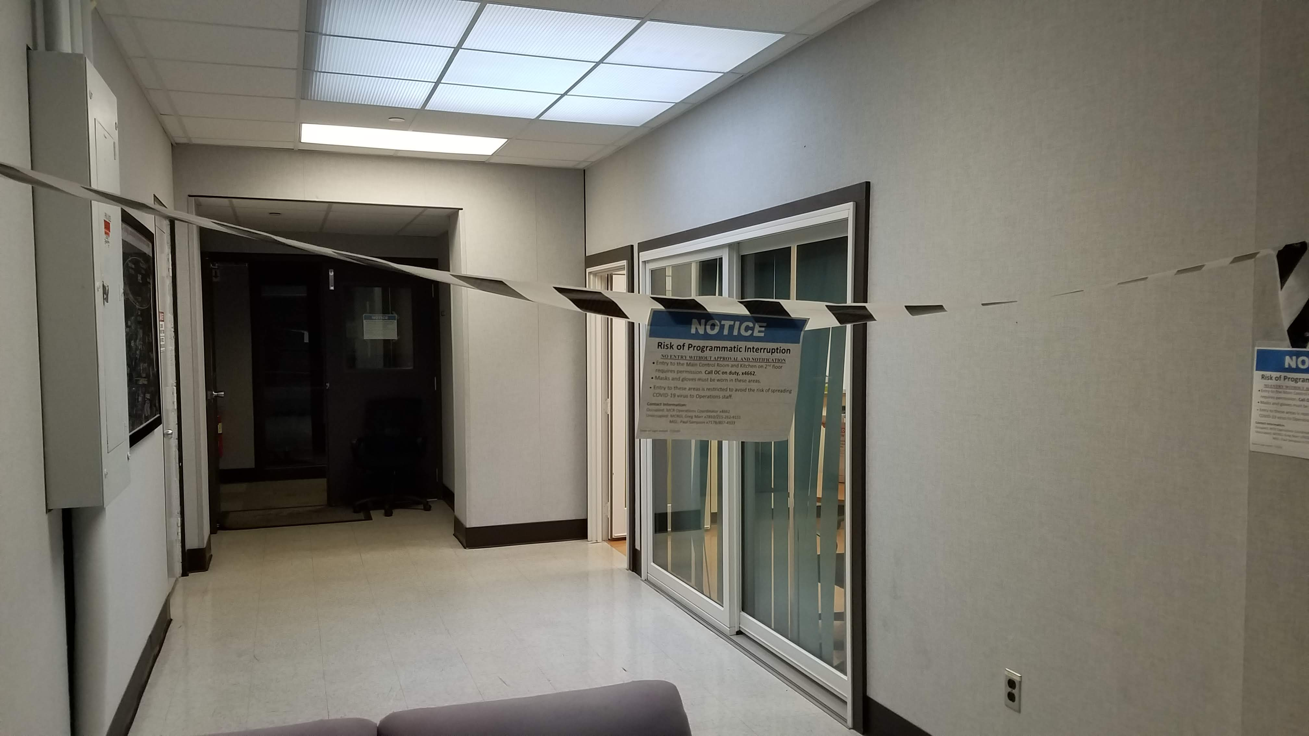
MCR becomes sacrosanct
We basically had to face the fact that a single case of COVID in the MCR shuts down the machine for two weeks while we still have to pay the electric bill for cryo ops
Operations group worked out a set of rules
No casual visitors. All visitors are highly discouraged. No one enters without telephoning the Coordinator for permission
MCR shifted to 12 hour crews with no overlap
Face coverings mandatory
Kitchen outside MCR reserved for MCR staff only (at this point it is still not clear how easily surfaces can pass on COVID)
Secondary remote MCR set up in a small conference room for LEReC
Creating this list took weeks and hundreds of emails among the 24 people in the group. We had the full range of feelings regarding COVID – some didn’t worry about it at all and some were convinced they could get it from everything. In the end we went a little overkill, but it made everyone feel better.

Slide 8
4/21/20
Ernest Courant, BNL scientist and father of strong focusing passes away at home

Slide 9
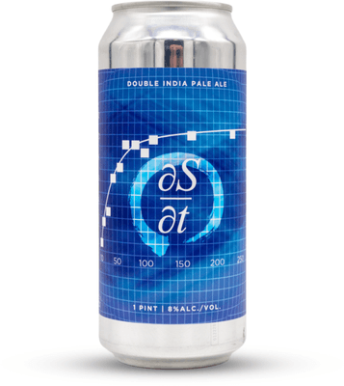
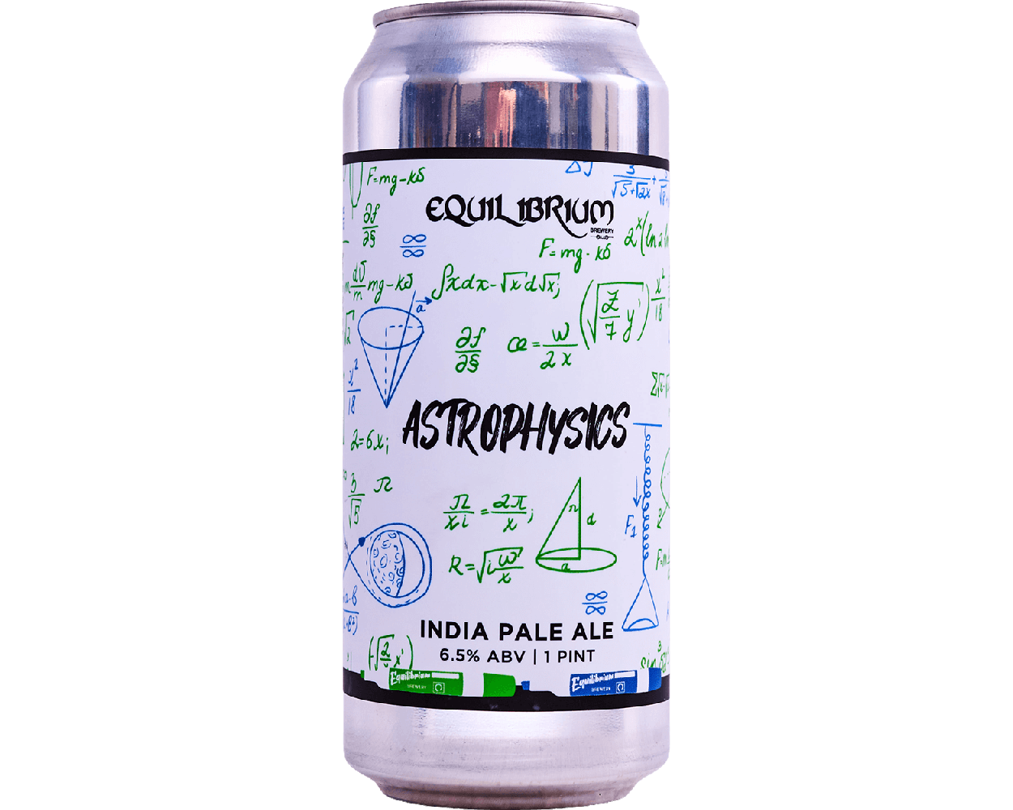
May 2020
Total cases are up to 30k in Suffolk county but daily positive tests have dropped to a couple hundred per day while testing continued to increase
NY state extends its shutdown of all non-essential businesses to 5/25
Preparations underway for an early June return to collider operations
MCR is back in person running Booster beam for NSRL (NASA Space Radiation Lab). Setup was done in person and went smoothly.
Equilibrium brewing company in NY and The Alchemist in VT stay open, an utter lack of traffic enables supporting these fine businesses with 6-12 hours of driving in a day.

Slide 10
6/6/20
MCR staffing begins for system checkout with a 2 man support crew on site. Equipment failures that they can’t handle require call-ins during the day with most people still teleworking.

Slide 11
6/12/20
Gold beam injected into the AGS and accelerated to flattop by remote injector machine specialist
LEReC personnel working from satellite control room have established the electron beam to full energy
Extraction to the dump just upstream of RHIC injection done remotely
This is actually not this first time we had done this, I’m not really sure why I was anxious about it.

Slide 12
6/15/20
RHIC available for beam @1540
“I am not excited about the prospect of doing a ‘from scratch’ turn on entirely remotely” – Injector Physicist
Injection, RF capture, instrumentation setup, collimation and collision setup all done by 0000.
Physics Running declared two days later, delay due to issues with STAR systems, not machine performance.

Slide 13
So amazing success. But…
MS Teams group chat replaced the conversations that used to happen vocally in the control room, but since people now have to type to do it there were a lot of comments that should have been entered into the elog but weren’t. We are still working to improve that.
Our main control room is like a teaching hospital – operators learn from watching and doing. Having all the specialists working remotely has definitely impacted the learning of our newer operators. I have no guidance on how to fix this, I’m just happy that going forward we can get back to more in person setup.
Early on in this process it became so easy to sit down and ‘just check on the machine’ from home that people found themselves working waaayyyy too many hours. It is imperative that people find a balance in their lives.

Slide 14
Thank You

